Slide 1

SWIFT UAV
Structural Systems v0.2.3

Slide 2
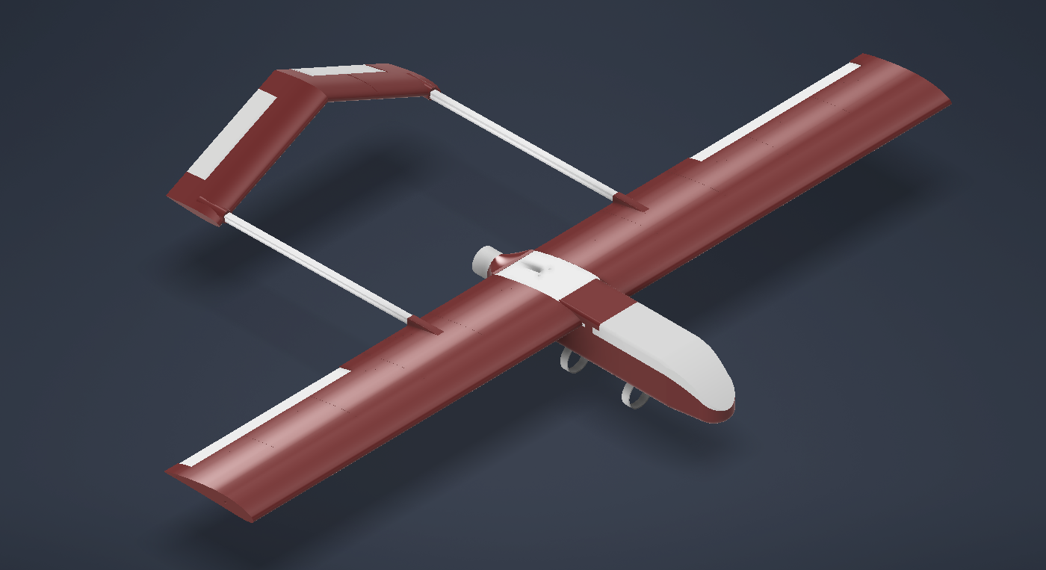
Design & Manufacturing Progress
Current design iteration is focused on:
Structural improvements
Operational improvements
Design for manufacturability
The current (v0.2.3) UAV design is in production
Initial prints confirm the validity of design changes

Slide 3
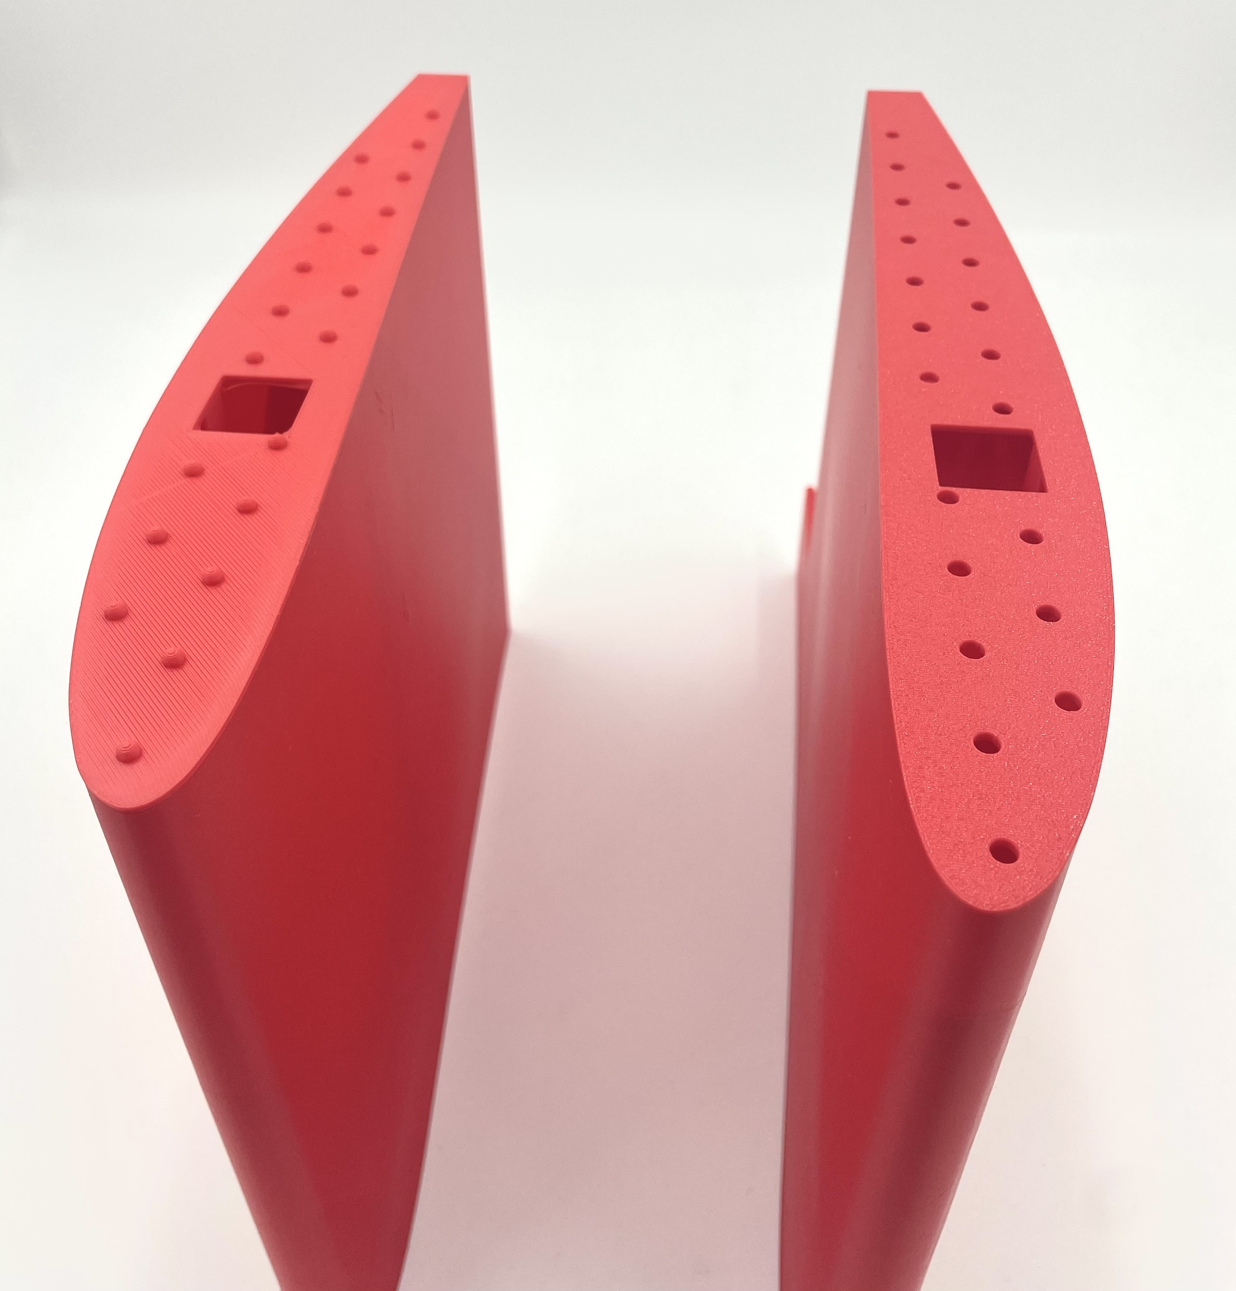
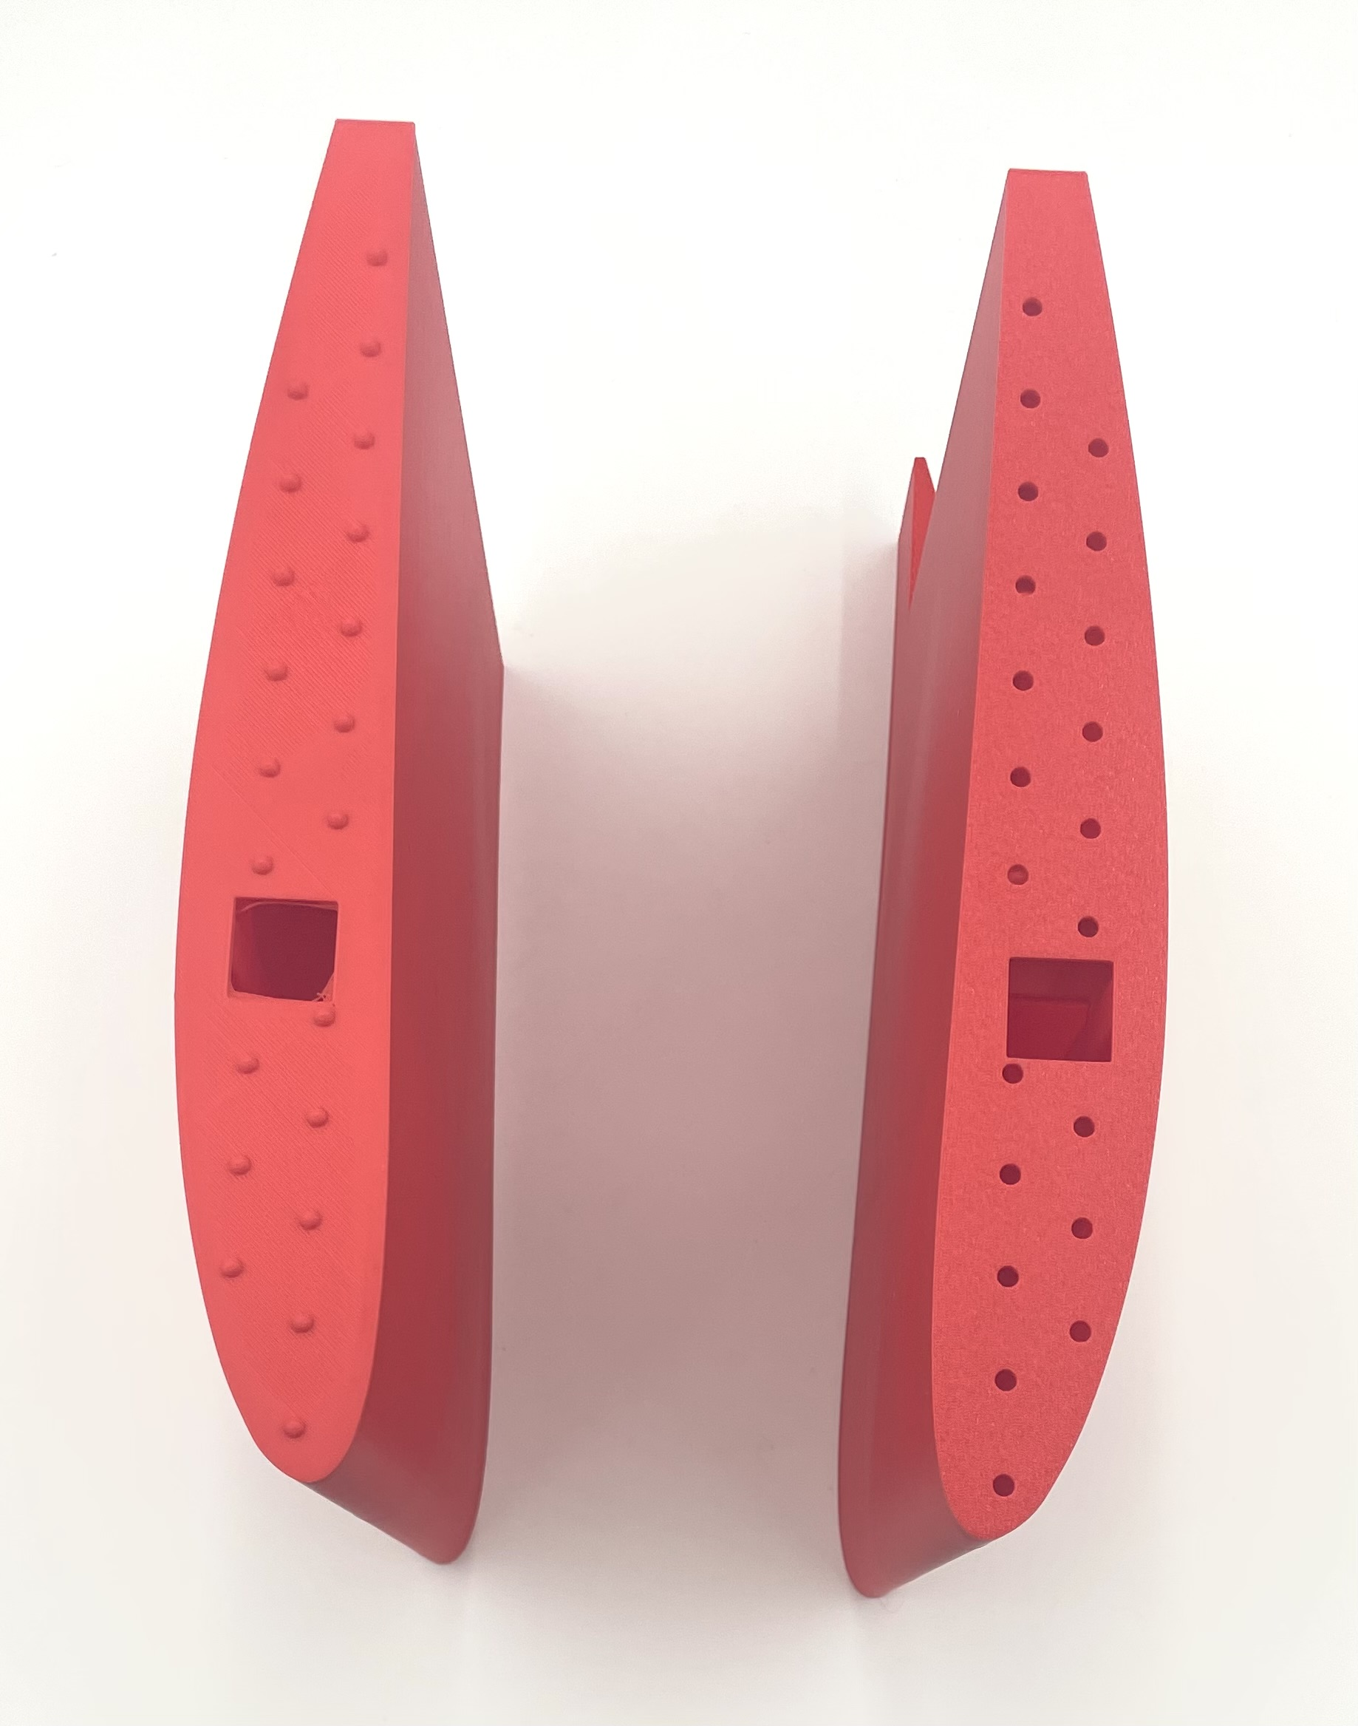
Structural Modifications for Assembly
Locking nubs have been added between wing segments
They provide multiple structural and functional benefits:
Load Transfer: Enables transfer of shear loads between wing sections
Improved Assembly: Enables part indexing for easy assembly
Torsional Stiffness: Increases torsional resistance substantially

Slide 4
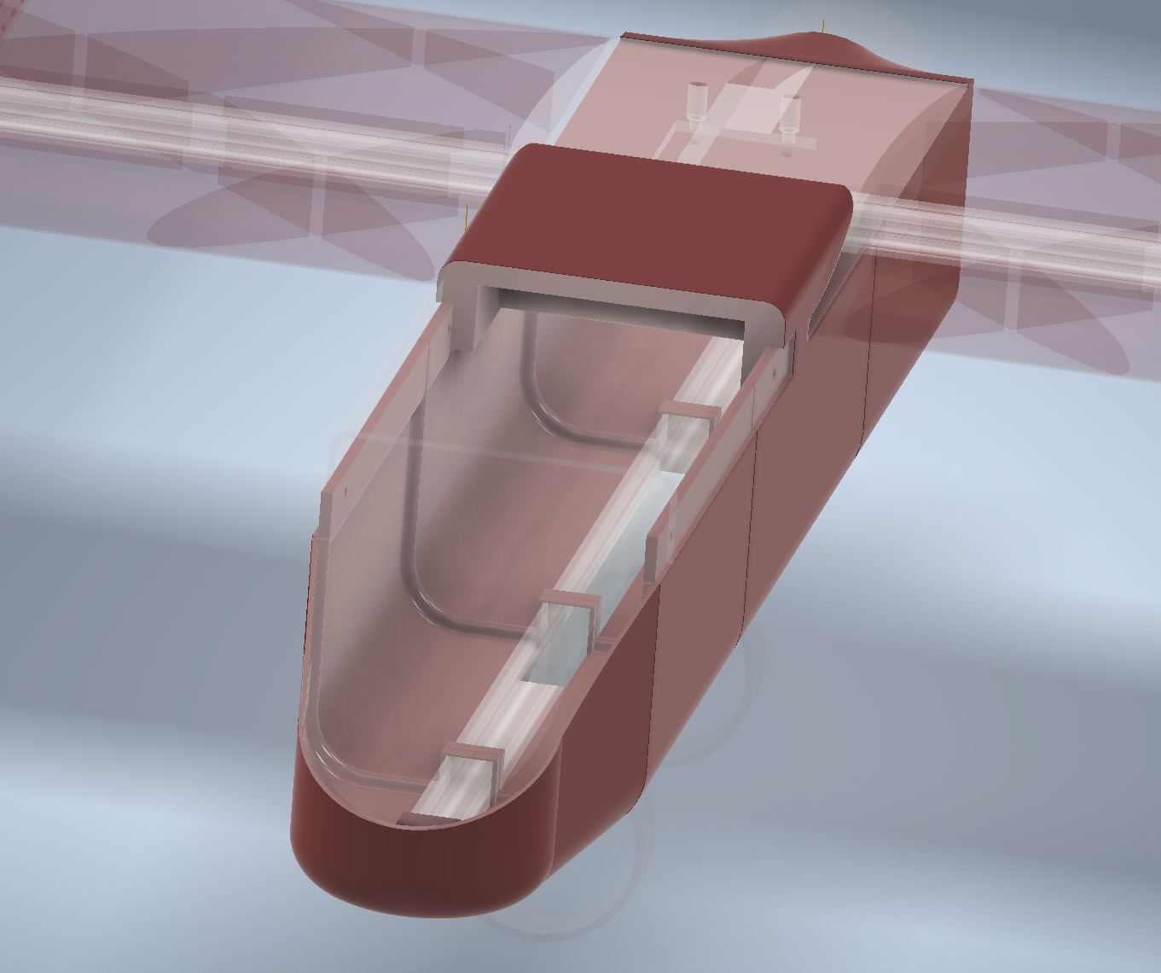
Structural Modifications for Assembly
Tabs have been added to fuselage sections
Provides indexing points to streamline manufacturing and increase joint rigidity
A slot has been added to the fuselage cover
Makes for easier and more ridged assembly
A 2020 rail has been added in the fuselage to:
Reinforce the fuselage
Act as a mounting point for the landing gear
Act as a hardpoint for payloads

Slide 5
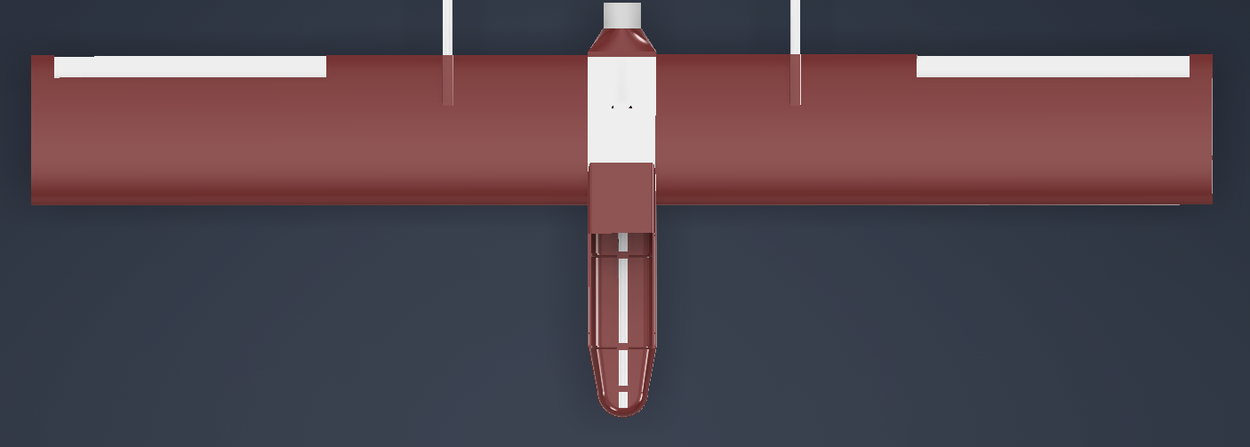
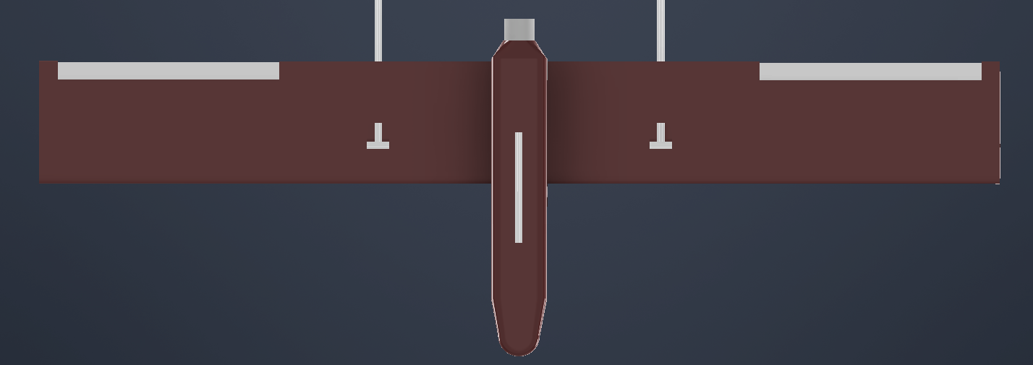
Avionics Integration
Preliminary Avionics integration is being conducted in parallel with the manufacturing
Ensuring that mounting points and clearances for all the hardware correct
The 2020 aluminum bar embedded into the fuselage base also serves:
A universal mounting interface for avionics trays and payloads.
And enables easy reconfiguration of internal loadout for missions

Slide 6
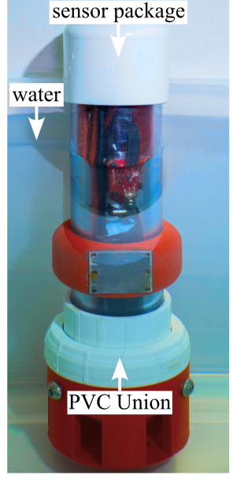
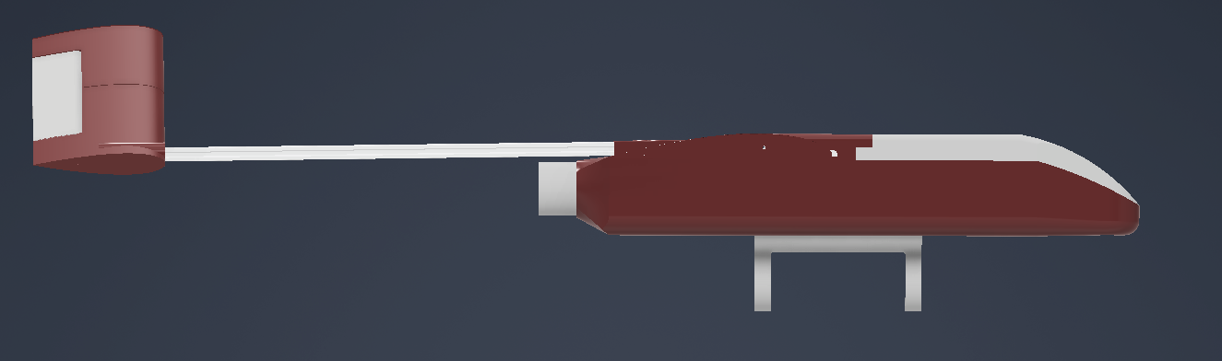
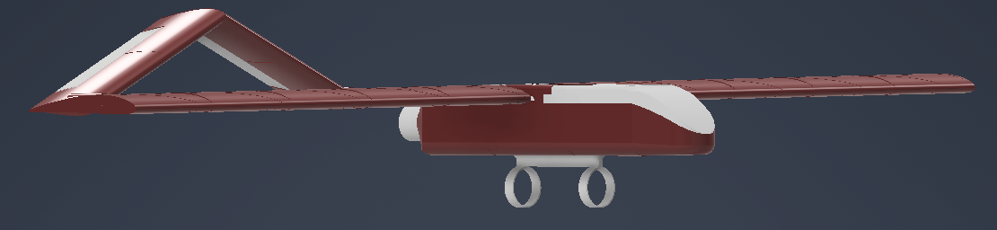
Payload Accommodation
A simple pylon structure as added support the mounting any of the 2" PVC chassis sensor packages the lab has developed
Ex. Deployable water quality sensor
This modularity allows for collaborative research projects
external partners can attach their instrumentation without substantially altering the aircraft.
Future upgrades may include quick-release interfaces.

Slide 7
Next Steps
Currently
Printing v02.3
Next
Full 'Iron Bird'
Design Review
V0.3 Design
Updated weight and CG caluation
Landing gear implimentation
Tail design revision
Further design for manufacturability improvments
Assembling v0.2.3

Slide 8
Thank You for Your Time
Lab GitHub: github.com/arts-laboratory

